Slide 1
A Project Presentation
On Tourist And Tourisam Management System
Group No :- 34
24034211065 :- Patel yash .N
Enrollment No :-
24034211092 :- Thakor Jayesh

Slide 2
INTRODUCTION
Tourist and Tourism Management System is a lightweight web application that connects travelers, tourism service providers (like travel agencies, tour guides, hotels), and administrators to streamline travel planning, tour bookings, and management of tourism services.
It allows tourists to browse travel packages, book tours, and make secure payments online. Service providers can list their offerings, manage bookings, and communicate with customers in real-time. The admin panel helps monitor system activity, user registrations, payments, and overall performance of the platform.
Goal of the System: To digitalize travel and tourism services to improve accuracy, speed, and customer satisfaction.
<Group No.-34

Slide 3
1.1 Project Profile
Project Title | Tourist And Tourisam Management System
Objectives | Manage travel packages, bookings, customers, and payments.
Frontend | HTML, CSS, JavaScript, Bootstrap
Backend | PHP, MySQL
Others | Vs code
Group No | 34
Enrollment No. | 24034211065, 24034211092
Names of partners | Patel Yash ,Thakor Jayesh
Company Name | Gujarat TravelTech Solutions Pvt. Ltd.
Company Address | Infocity, Gandhinagar, Gujarat – 382007
Internal Guide | Mr.Sanjay Patel

Slide 4
1.2 About the Organization
• Gujarat TravelTech Solutions Pvt. Ltd. is a fast-growing travel and tourism company specializing in customized tour packages and travel management services.
• The company focuses on offering affordable and high-quality travel experiences for customers across various destinations.
• It aims to deliver reliable and comfortable travel solutions with a customer-first approach.
• Gujarat TravelTech ensures a seamless booking and travel experience through digital innovation and efficient service.
• The organization blends tourism expertise with modern technology to simplify tour planning and enhance customer satisfaction.
*
<Group No.- 34>

Slide 5
SYSTEM STUDY AND ANALYSIS
*
<Group No.- 34>

Slide 6
2.1 Problem Statement
• With the rapid growth of the travel and tourism industry, there is a need for scalable, secure, and user-friendly online platforms for booking and management.
• Existing travel booking portals are often cluttered and difficult to navigate for users.
• Travel agencies face high commission charges and limited brand visibility on large aggregator platforms.
• There is a lack of 24×7 customer support to assist travelers during their journey.
• Customers do not have access to quick query resolution or self-service features for managing bookings and packages.
*
<Group No.- 34>

Slide 7
2.2 Existing System
MakeMyTrip – A widely used online travel portal offering flights, hotels, and tour packages. However, it charges high commissions and has a cluttered interface.
Yatra – Provides travel booking services with good coverage but limited customer support and slow query response during busy hours.
Goibibo – Focuses on fast bookings and discounts but lacks personalization and transparency in additional charges.
*
<Group No.- 34>

Slide 8
2.2.1 Drawbacks
• High commission charges on popular travel booking platforms.
• Slow or limited customer support during trips.
• Dependence on third-party servers and aggregators.
• Complicated and cluttered tour search options.
• Expansion becomes costly for small travel startups.
• Travel agencies lose their own brand identity on big platforms.
*
<Group No.- 34>

Slide 9
2.3 Proposed System
• Travel-only booking and discovery platform.
• 24×7 AI travel assistant for instant queries and trip support.
• Smart hybrid recommendation system for personalized tour suggestions.
• Strong brand identity and better visibility for local travel agencies.
• Seamless and clutter-free discovery of destinations, packages, and stays.
*
<Group No.- 34>

Slide 10
2.3.1 Advantages or Comparison Study
Feature | Existing Travel Platforms | SmartTravel Portal (Proposed System)
Customer Support | Limited or delayed response during peak seasons. | 24×7 AI-powered travel assistant with instant query resolution and live trip guidance.
Reviews & Feedback | Reviews often mixed across destinations and services. | Destination-specific reviews, hotel ratings, and verified traveler Q/A for better decision-making.
Cost | High service charges & commission-based structure. | Low-cost, commission-free model ideal for startups and local travel agencies.
Suggestions | Generic “popular destinations” or trend-based suggestions | Smart hybrid recommendation engine analyzing user preferences, trip history, and budget.
Security | Data and bookings controlled by third-party platforms. | Full control with secure, encrypted data and independent booking management
User Experience | Cluttered and confusing interface with ads.
 |  | Simple, clean, and clutter-free travel discovery and booking experience.
*
<Group No.- 34>

Slide 11
2.3.2 Modules
(with short description)
User Module – Handles traveler registration, login, and profile management (personal details, preferences, and past trips).
Destination Module – Stores and displays detailed information about tourist destinations, hotels, and travel packages.
Booking Module – Manages trip bookings, cancellations, and itinerary updates for users.
Tour Management Module – Handles creation of new travel packages, trip schedules, and tour history.
Admin Module – Allows admin to add/edit/delete destinations, manage bookings, view user feedback, and oversee operations.
Payment Module (Optional) – Integrates secure online payment gateway for package bookings and ticket reservations.
*
<Group No.- 34>

Slide 12
1. Admin Module:
Manages system settings, package approvals, user activity, and secure booking/payment records.
2. Tourist/User Module:
Allows users to browse packages, make secure bookings, manage trips, and receive personalized notifications.
3. Operator/Service Provider Module:
Handles package creation, pricing, availability, customer feedback, and smooth communication with travelers.

Slide 13
DEVELOPMENT ENVIRONMENT
*
<Group No.- 34>

Slide 14
3.1 Hardware Requirement
 | Server | client
Processor | Intel Core i7 or higher | Intel Core i5 or higher
Hard Disk | 1 TB Or higher | 512GB or higher
System Memory | 4 GB | 2 GB

Slide 15
3.2 Software Requirement
 | Server | Client
Platform | PHP | Web Browser (HTML, CSS, JavaScript)
Operating System | Windows / Linux (Any with PHP) | Any Operating System
Web Server | Apache / Nginx | Google Chrome or Latest Browser

Slide 16
3.3 Programming Environment
Frontend:
CSS3: Provides styling, color themes, and responsive design.
JavaScript: Adds interactivity and dynamic functionality for a better user experience.
Bootstrap/Tailwind CSS: Ensures mobile responsiveness and provides pre-built UI
components.
HTML5: Structures the layout of the user interface, including menus, forms, and panels.

Slide 17
Backend:
MySQL: Relational database used to store and manage data (e.g., tourist details, bookings, transactions).
Apache Web Server: Handles HTTP requests and serves PHP applications.
XAMPP/WAMP/LAMP (optional): Local development environment for PHP and MySQL.
PHP: Server-side scripting language used to handle business logic, process requests, and connect with the database.

Slide 18
SYSTEM DESIGN AND DEVELOPMENT
*
<Group No.- >

Slide 19
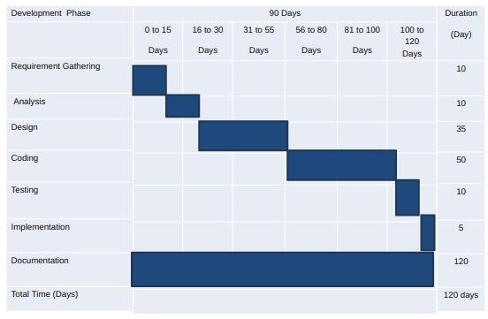
4.1 Time line chart

Slide 20
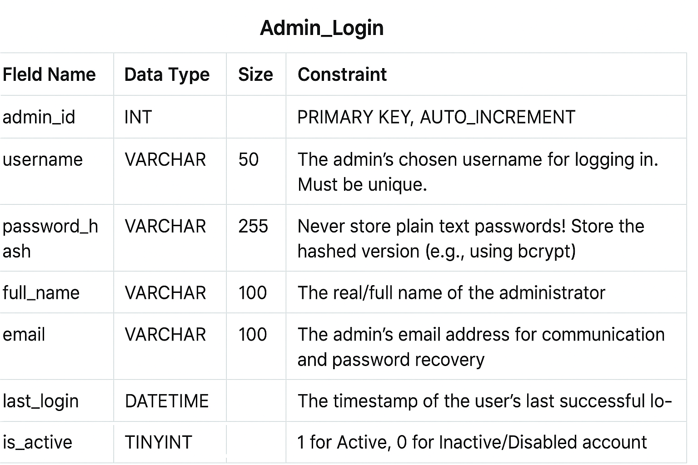
4.2 Data Dictionary
[1]Admin Login
Table name:-Admin Login

Slide 21
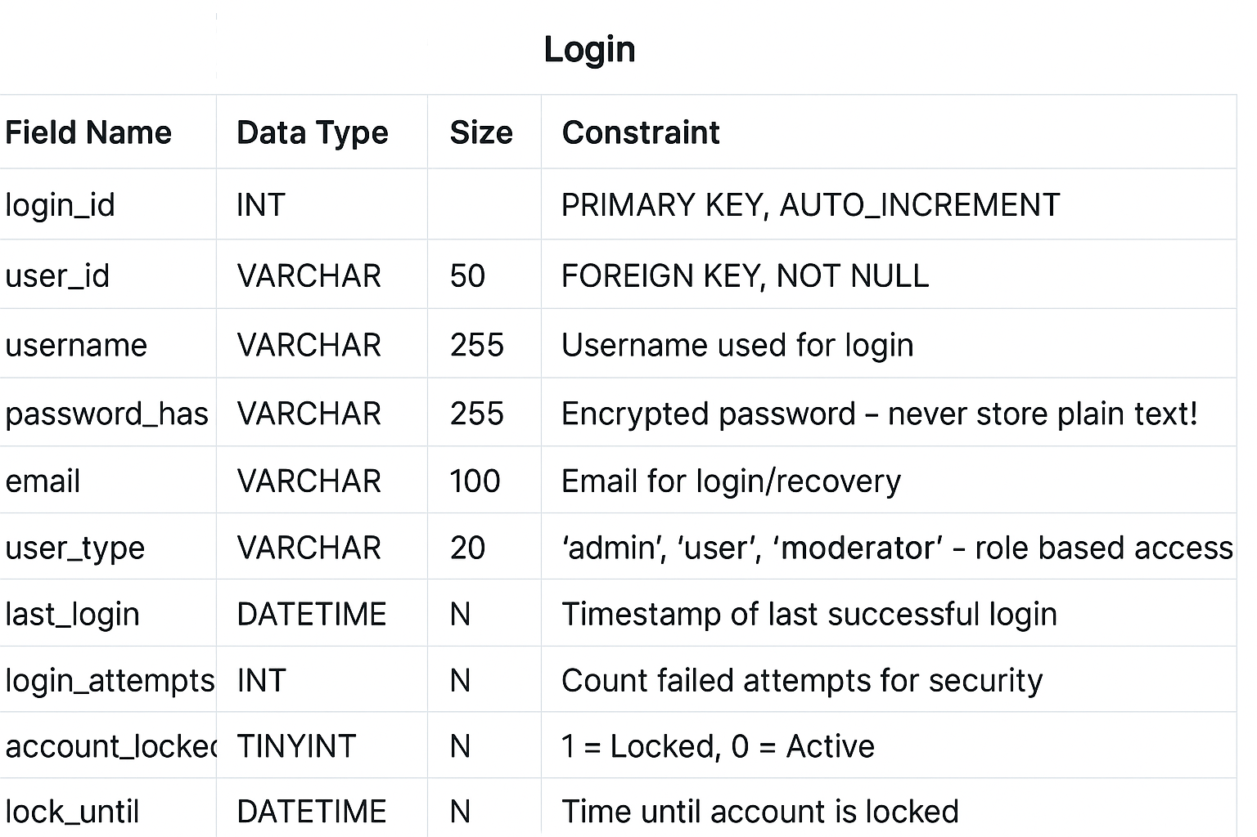
[2] Login
Table name:-Login

Slide 22
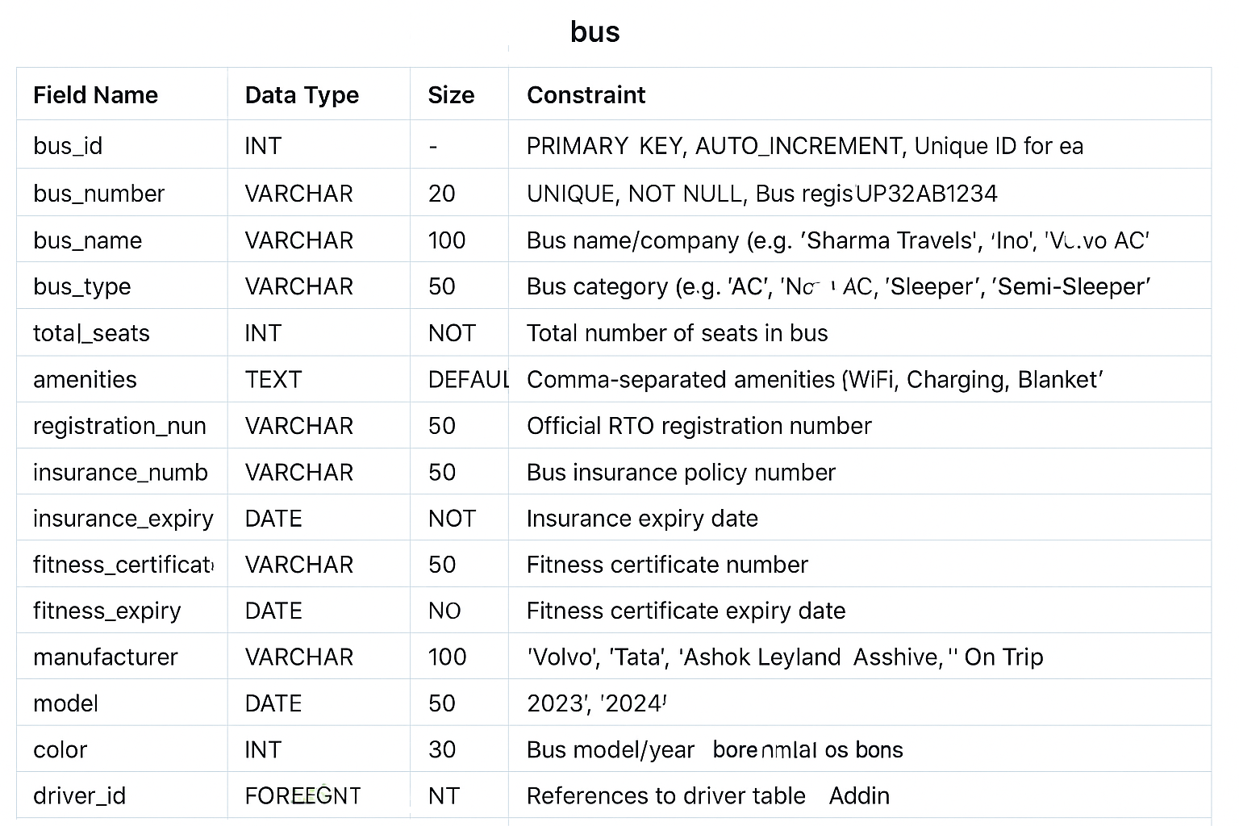
[3] Bus Table
Table name:-Bus Table

Slide 23
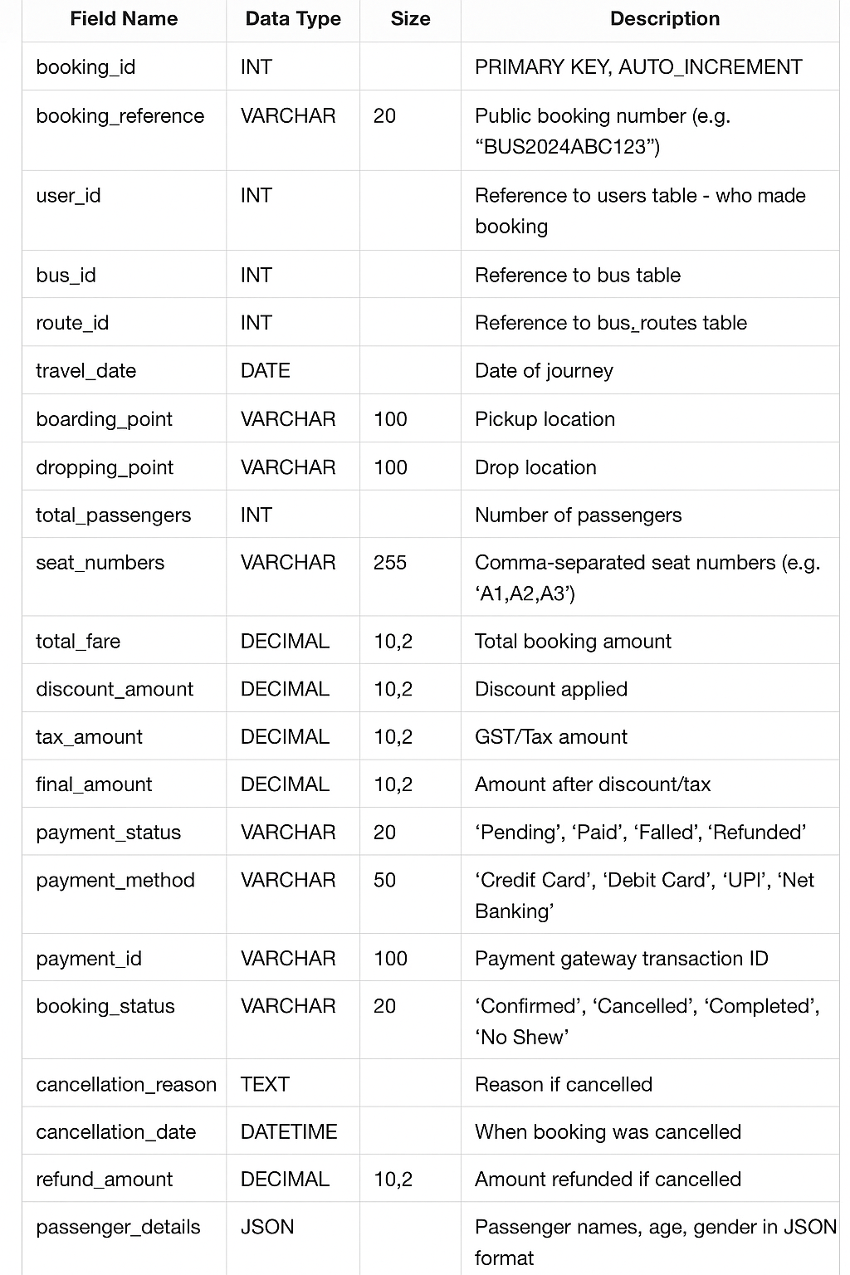
[4] Bus bookingTable
Table name:-Bus booking Table

Slide 24
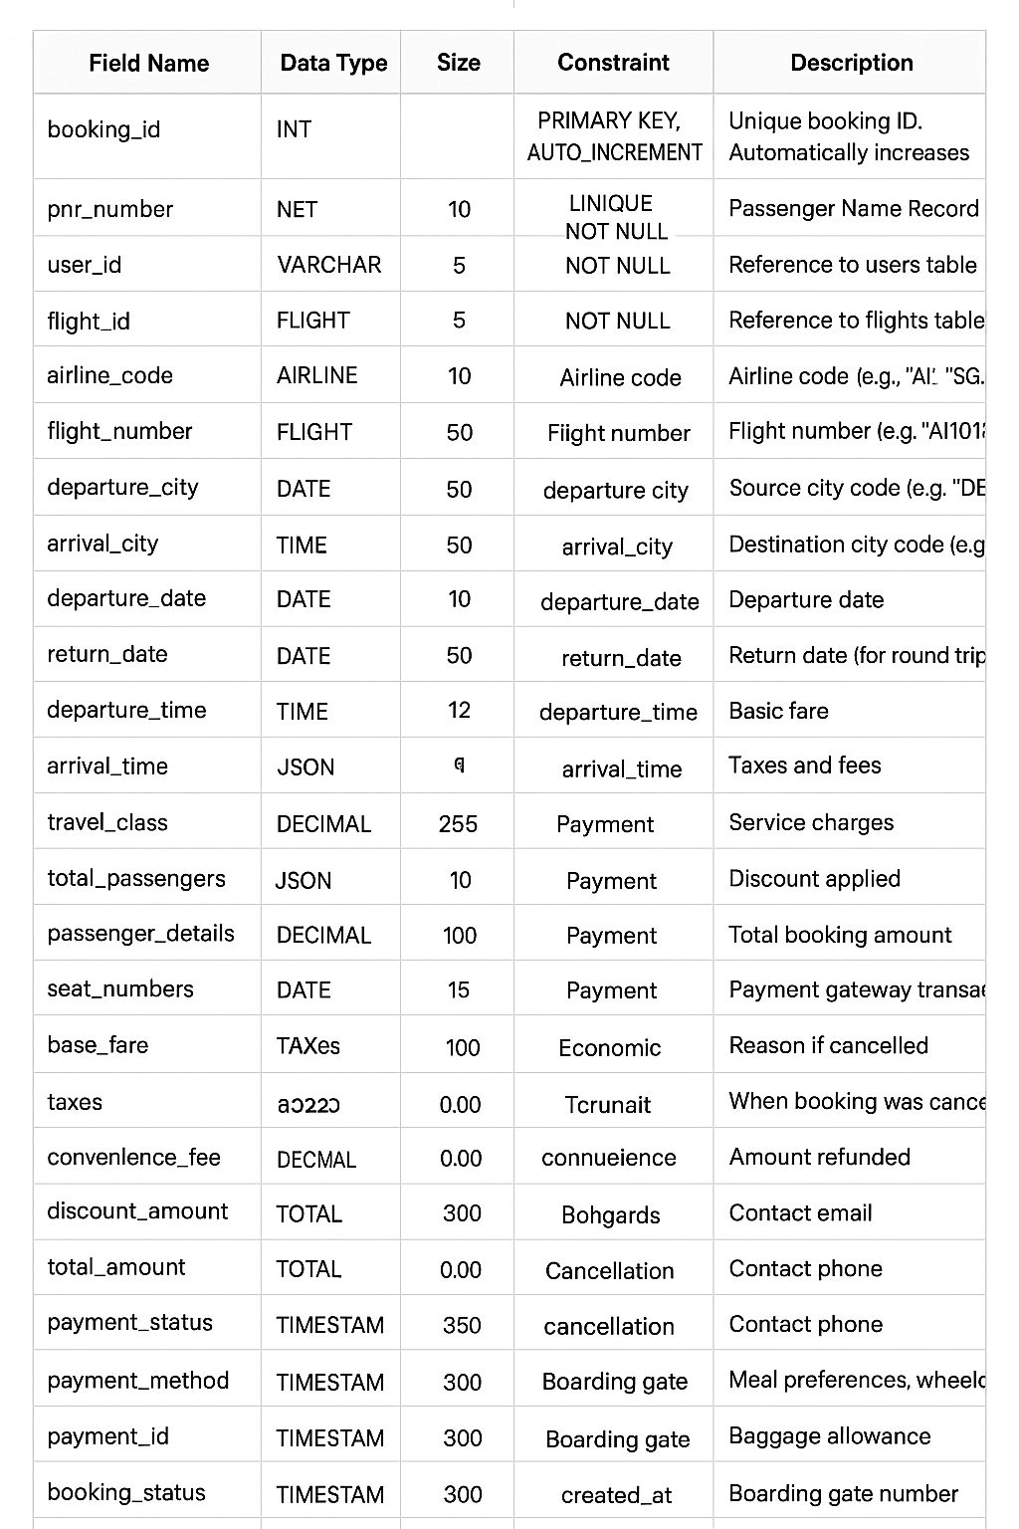
[5] Flight bookingTable
Table name:-Flight booking Table

Slide 25
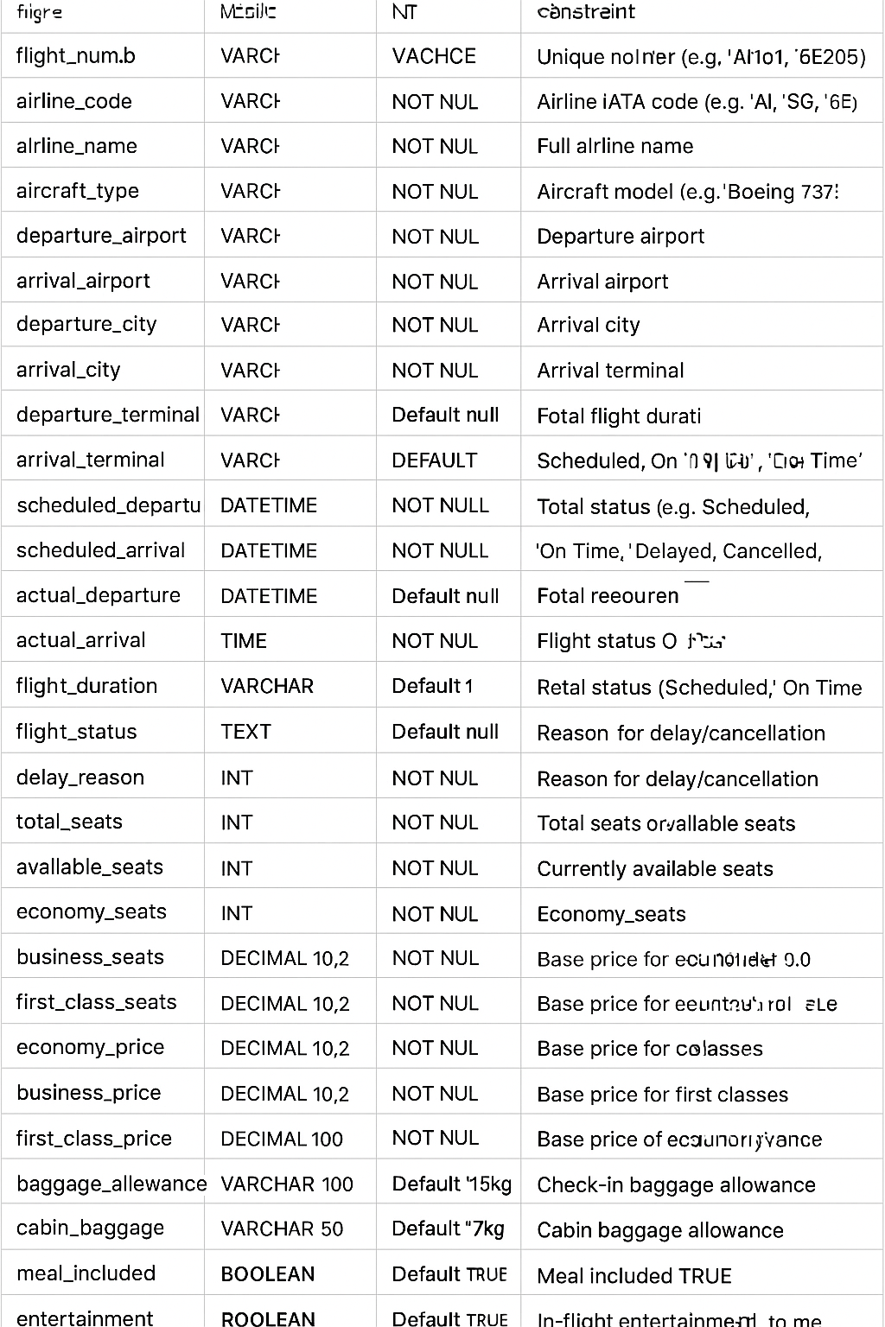
[6] Flight Table
Table name:-Flight Table

Slide 26
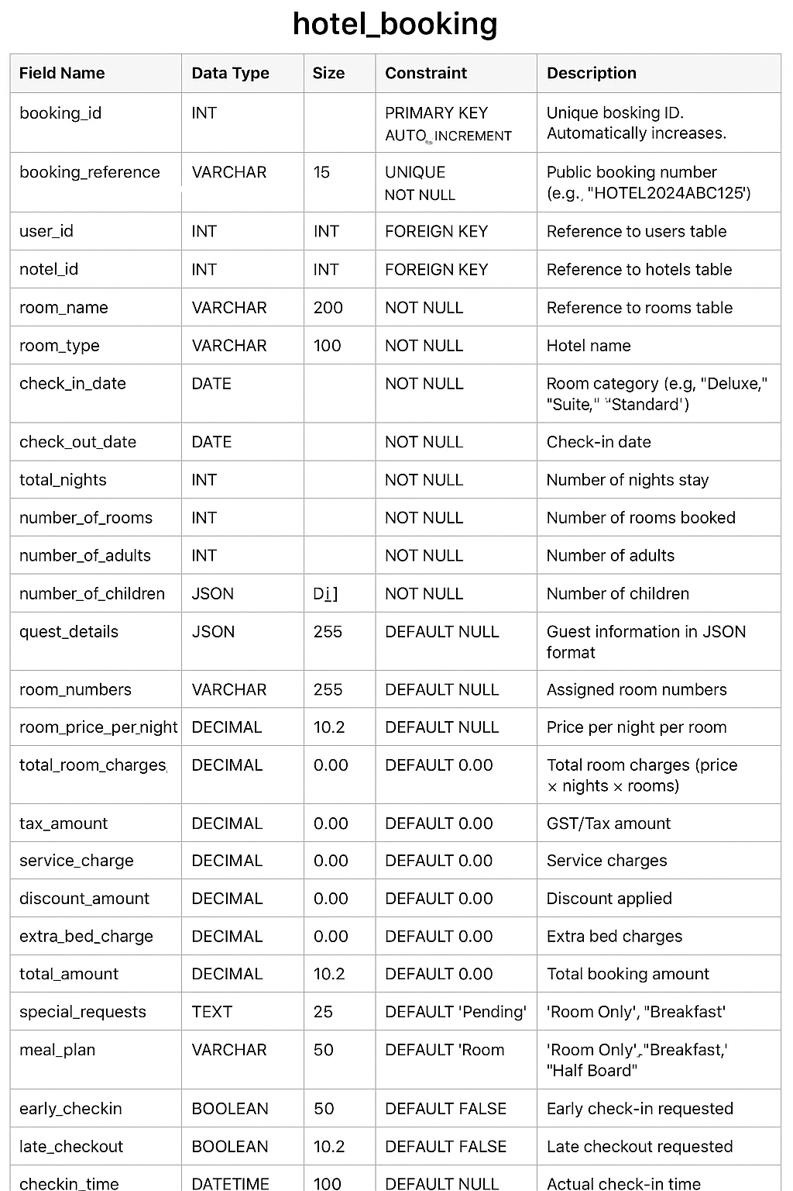
[7] Hotel_booking Table
Table name:-Hotel_bookingTable

Slide 27
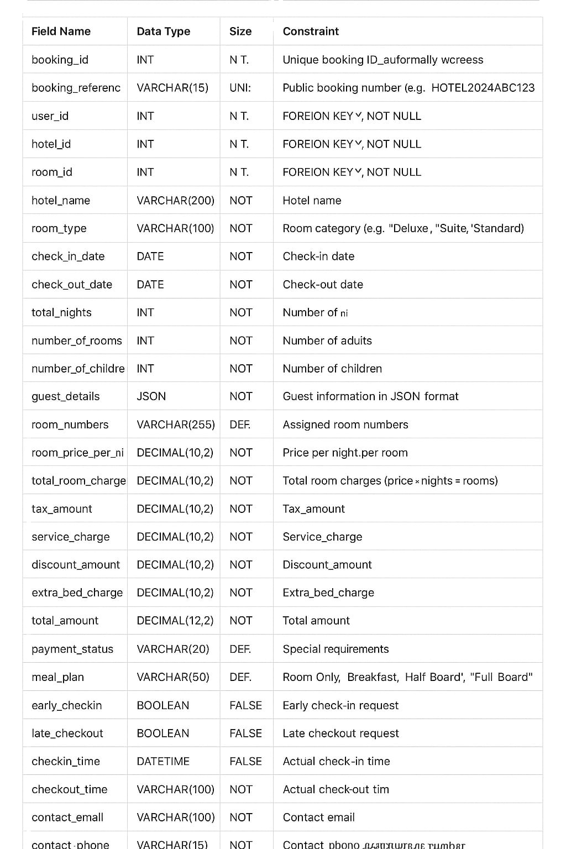
[8] Hotel Table
Table name:-Hotel Table

Slide 28
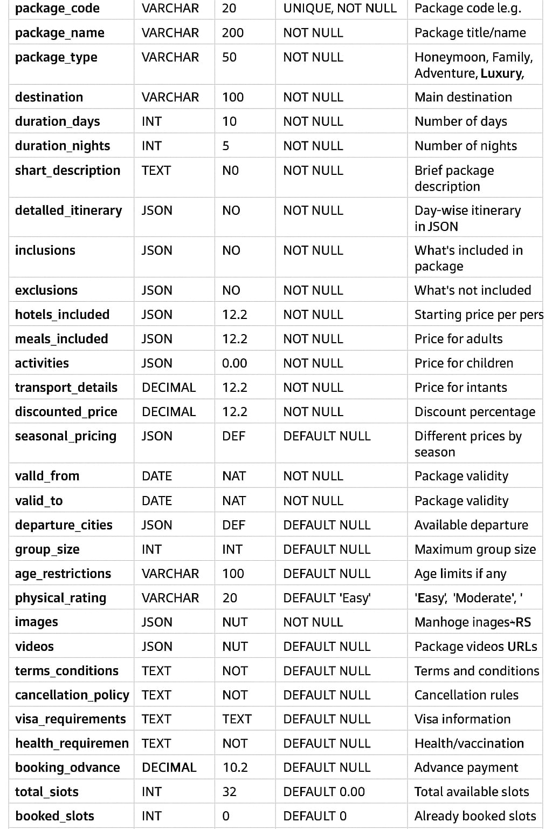
[9] Package Table
Table name:-Package Table

Slide 29
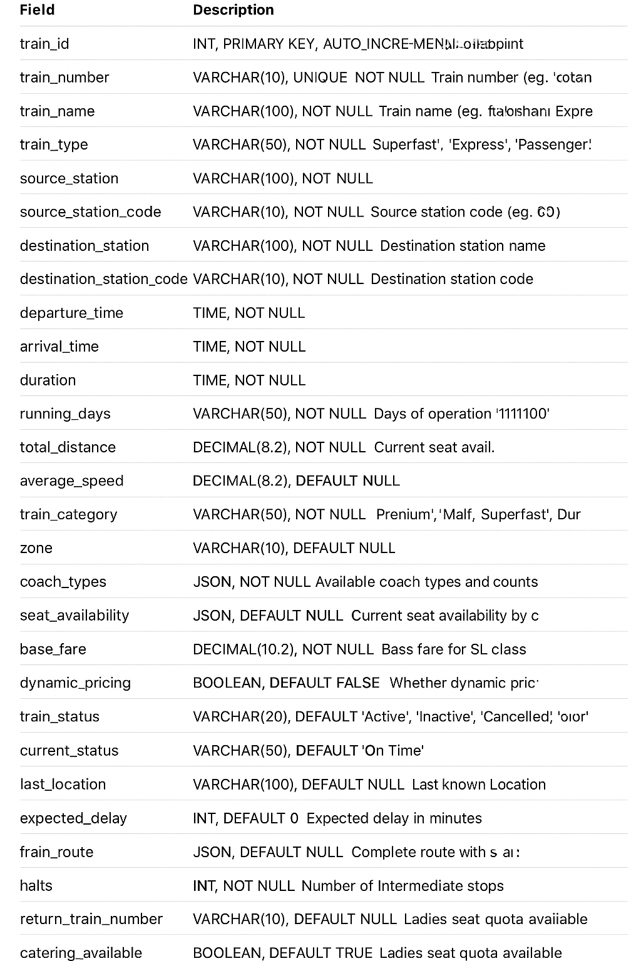
[10] Train Table
Table name:-Train Table

Slide 30
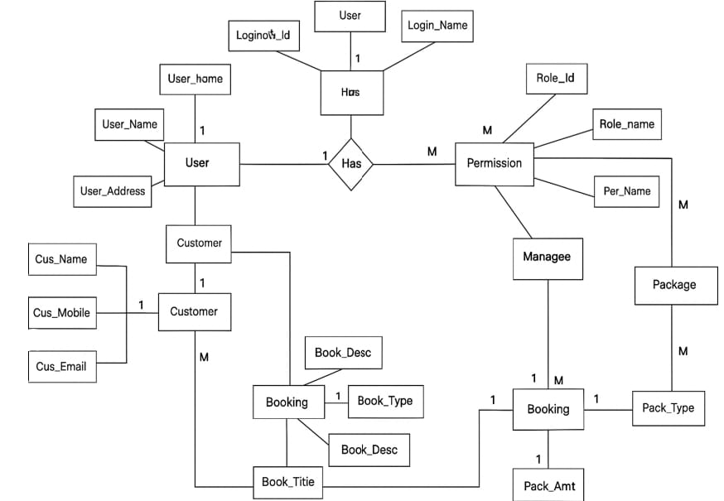
E-R Diagram

Slide 31
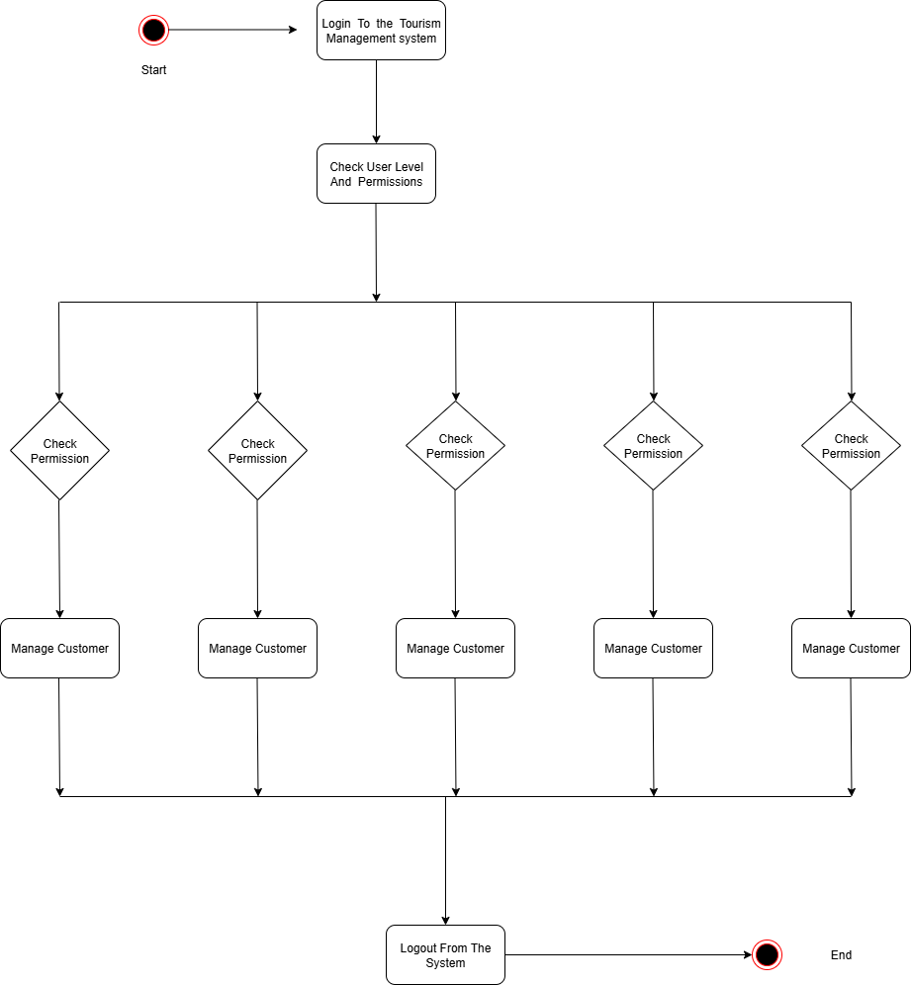
4.4 User Modeling Language Diagrams

Slide 32
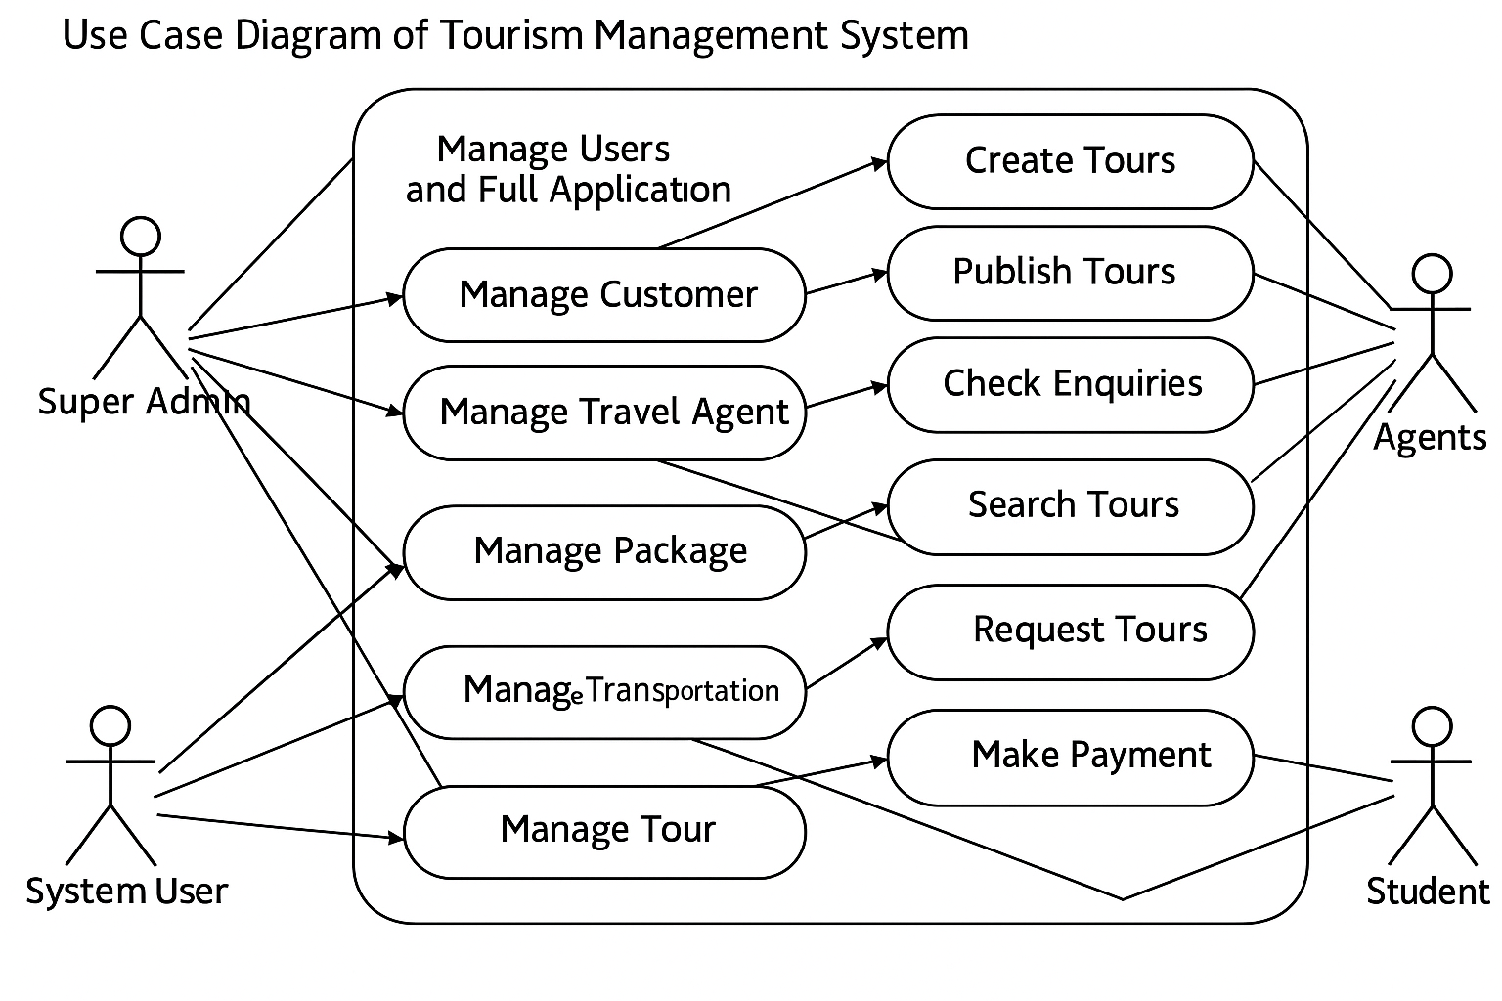
4.4.1 Use Case Diagram

Slide 33
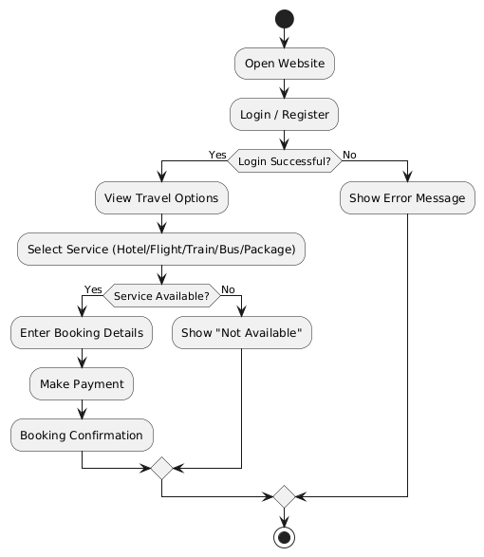
4.4.2 Activity Diagram

Slide 34
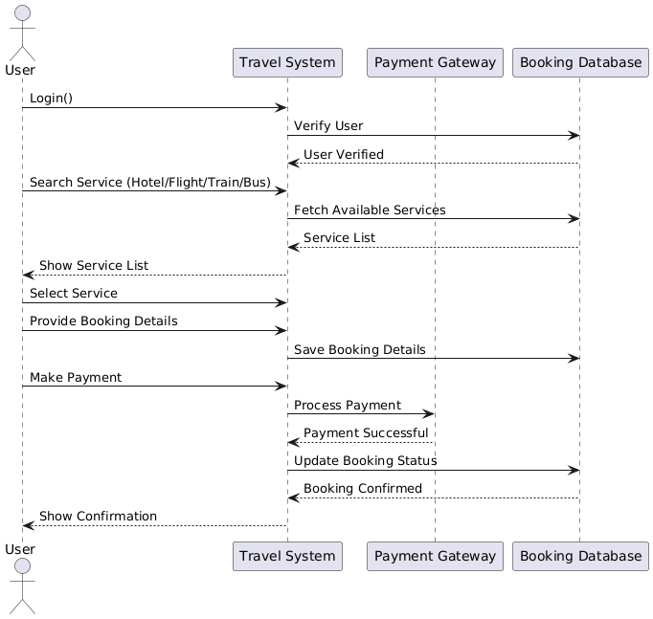
4.4.3 Sequence Diagram

Slide 35
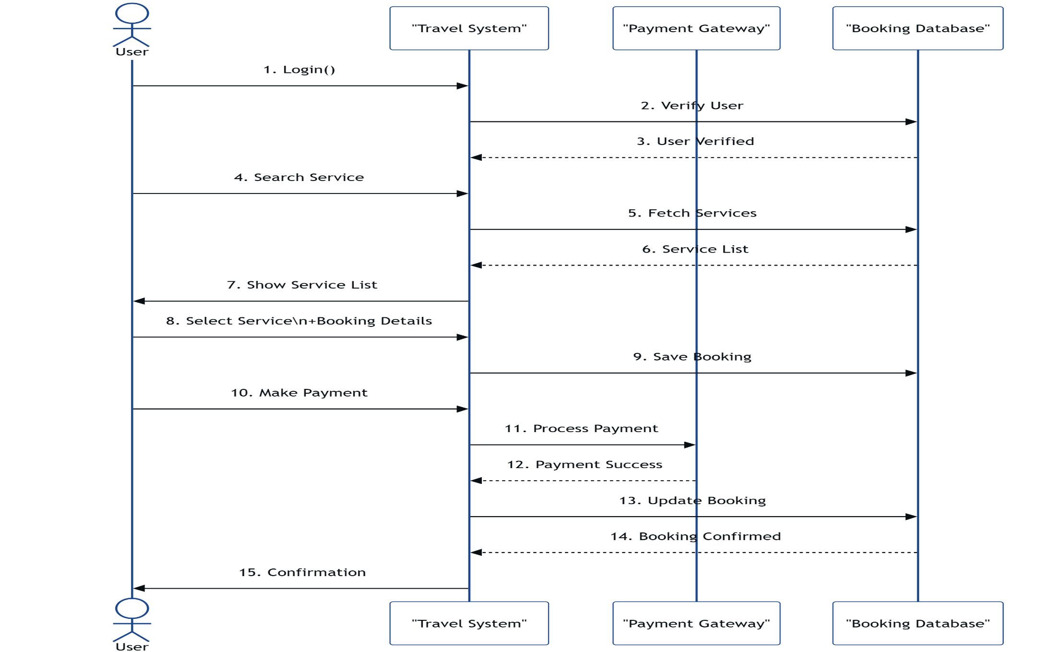
4.4.4 Collaboration Diagram

Slide 36
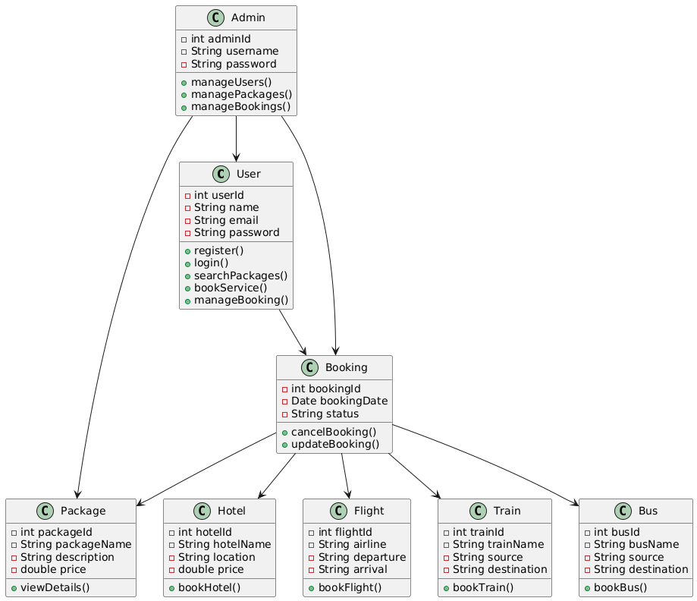
4.4.5 Class Diagram

Slide 37
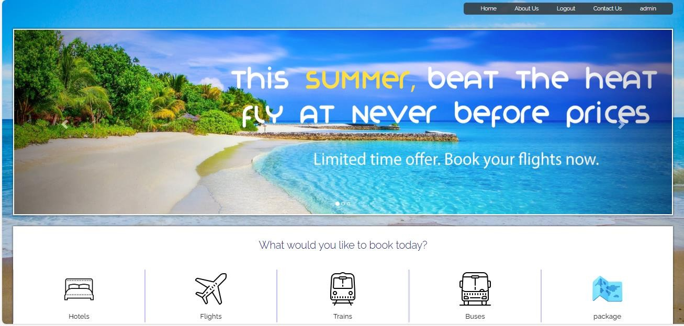
4.5 Input Design
Tourist and Tourism Management:Home Page

Slide 38
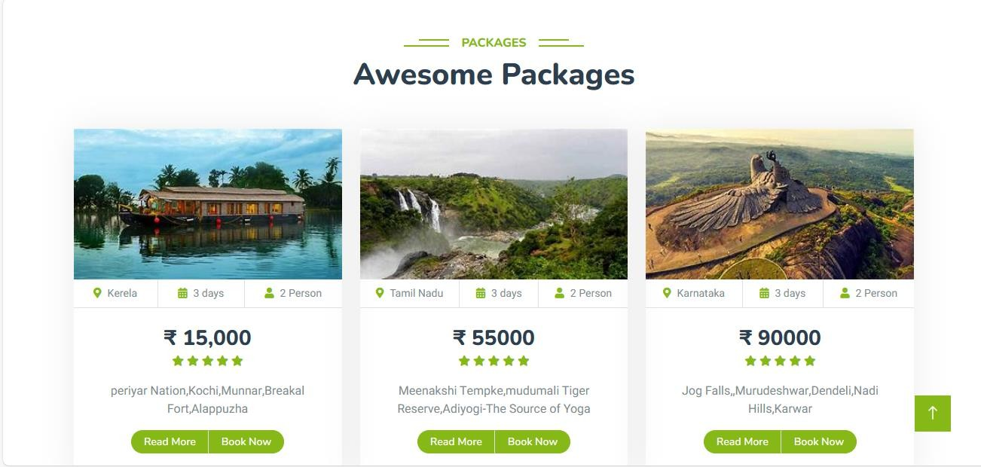
Tourist and Tourism Management: Package Page

Slide 39
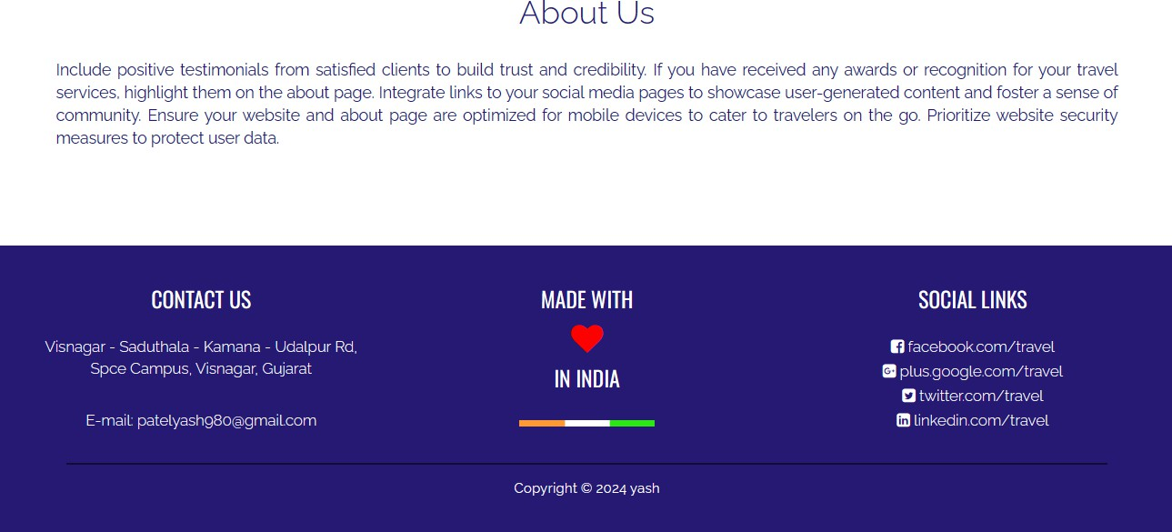
Tourist and Tourism Management: About Us page

Slide 40
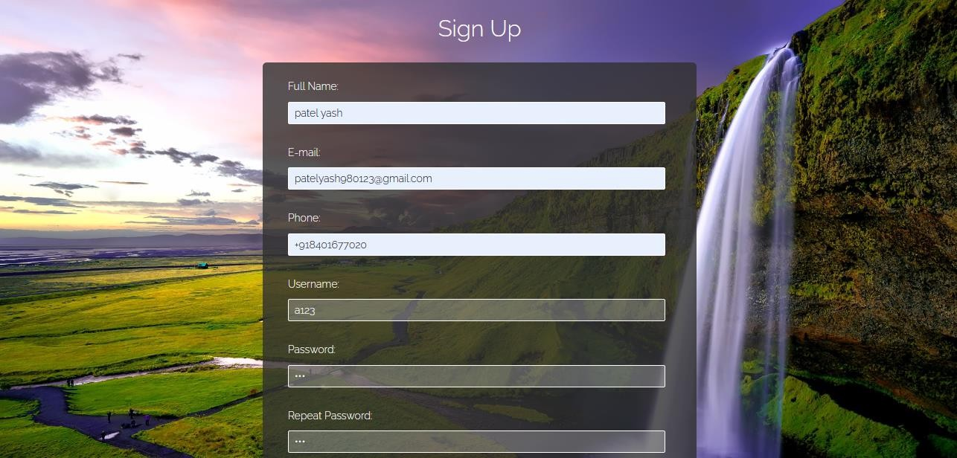
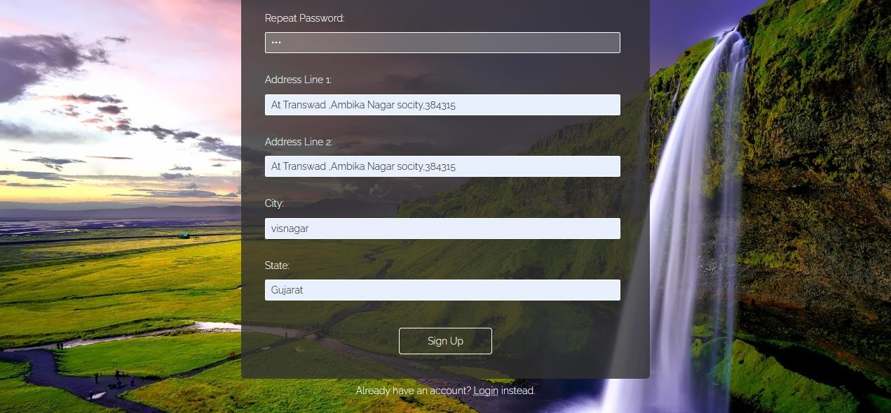
Tourist and Tourism Management: Registration page

Slide 41
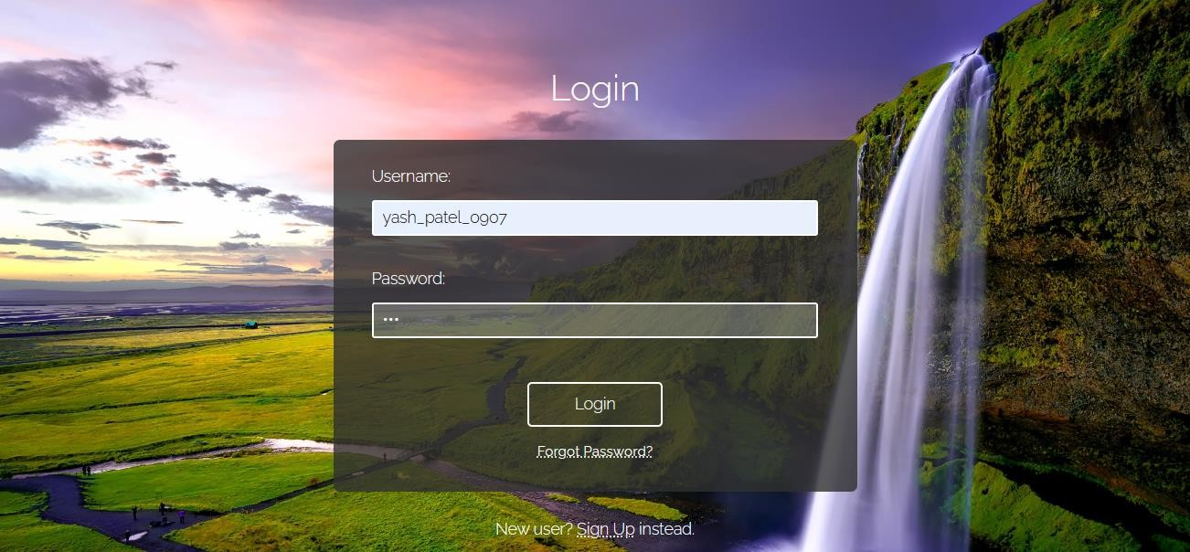
Tourist and Tourism Management: Login page

Slide 42
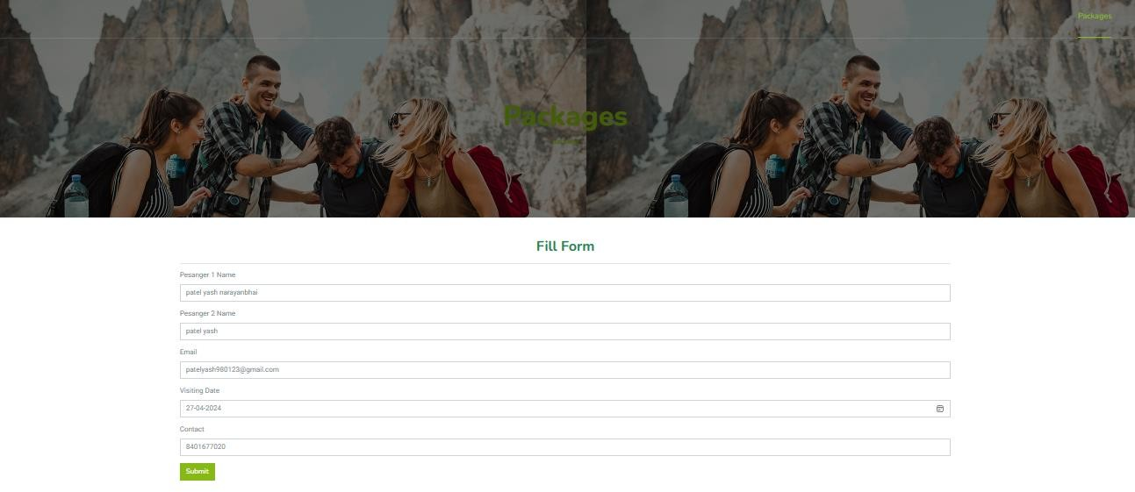
Tourist and Tourism Management: Package Booking

Slide 43
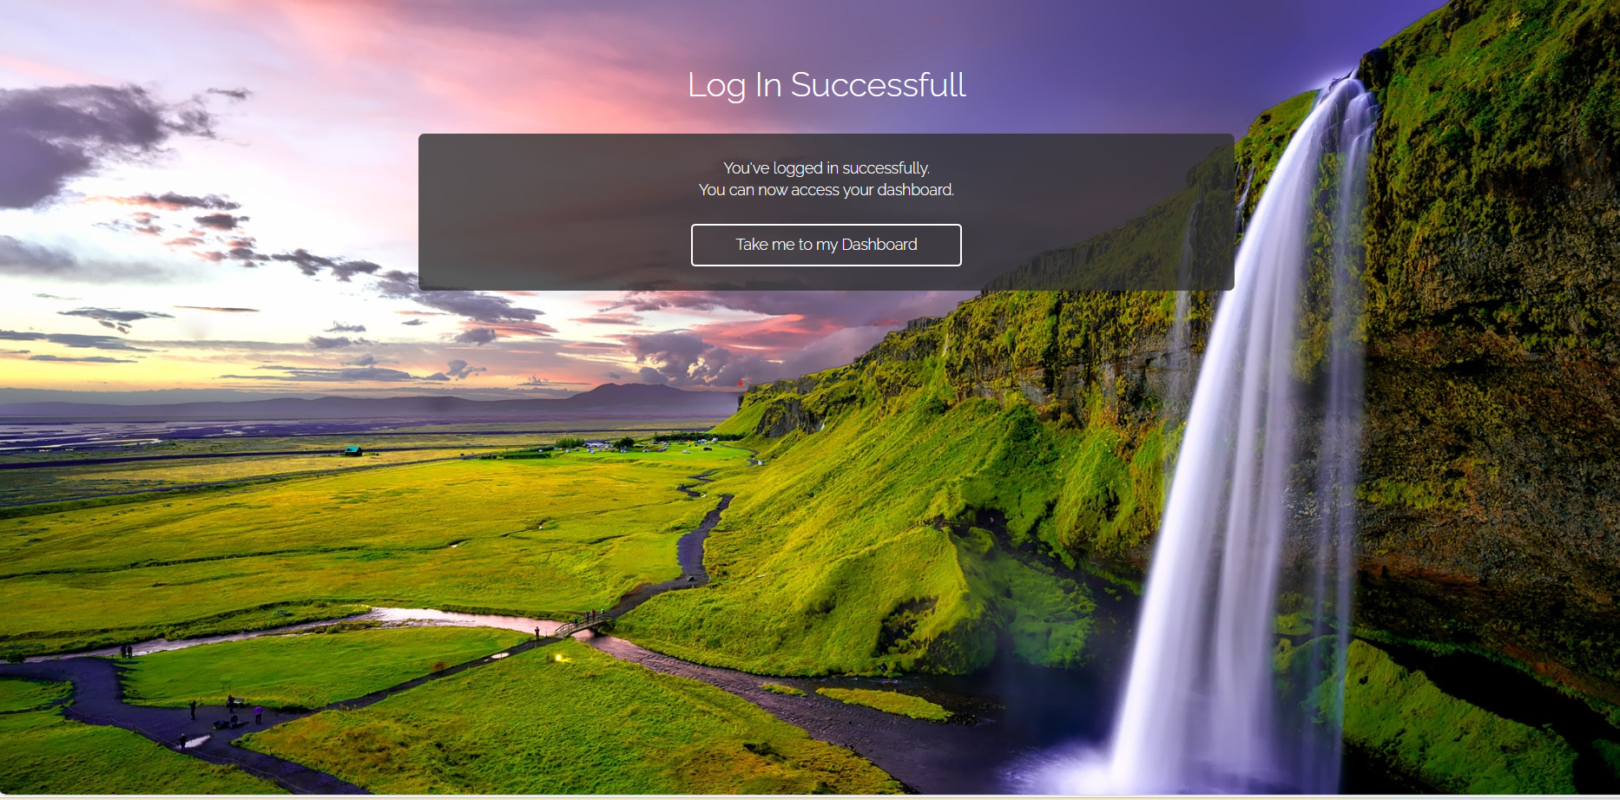
4.6 output Design

Slide 44
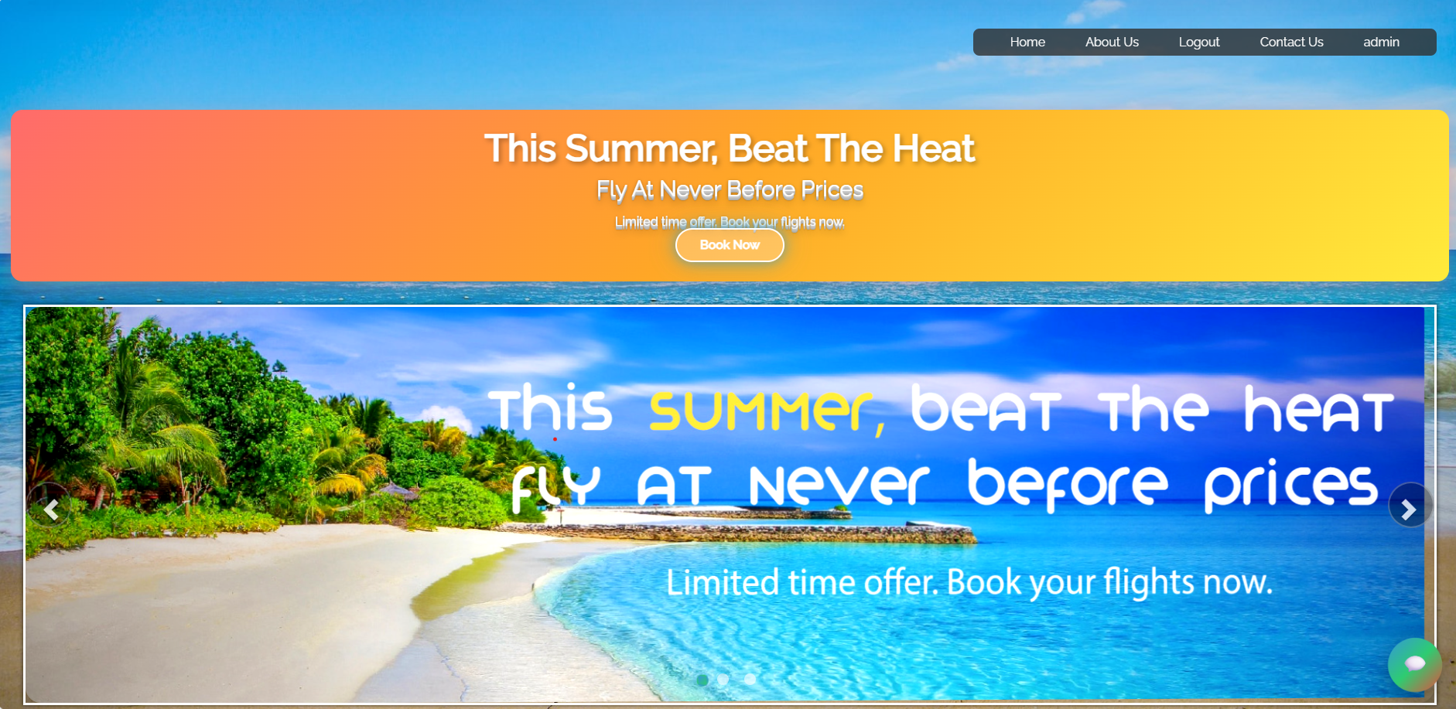
Sign In Page

Slide 45
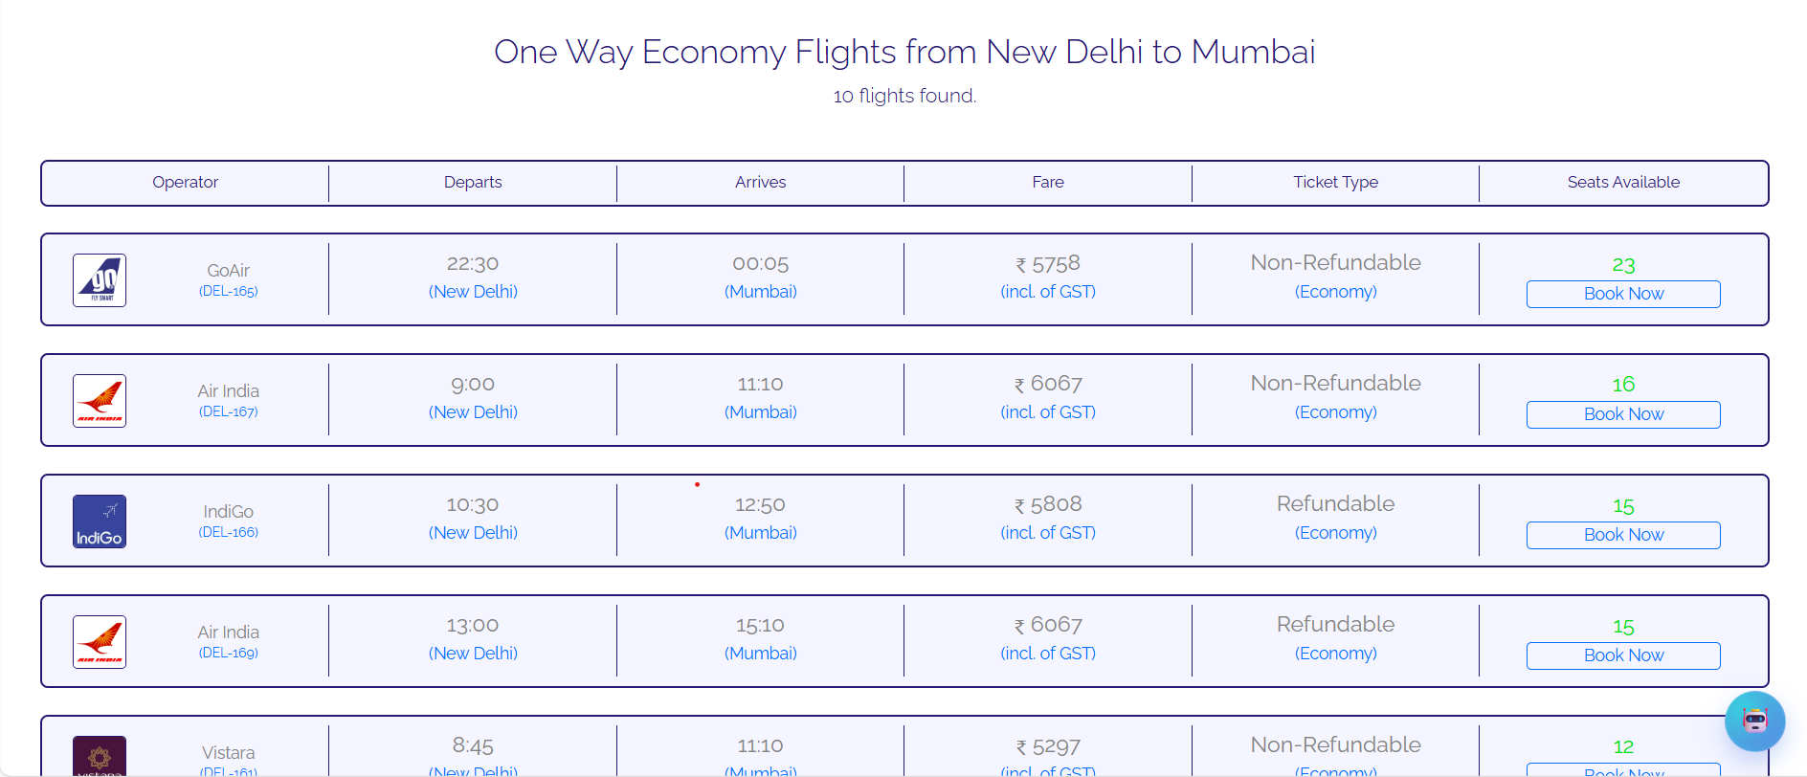
Search Bar

Slide 46
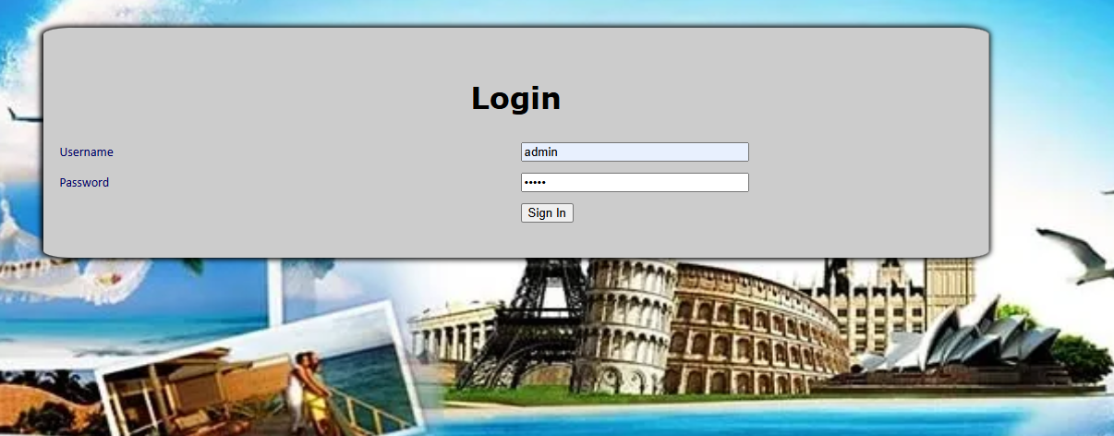

5.1 SYSTEM TETSTING
Admin Page Input

Slide 47
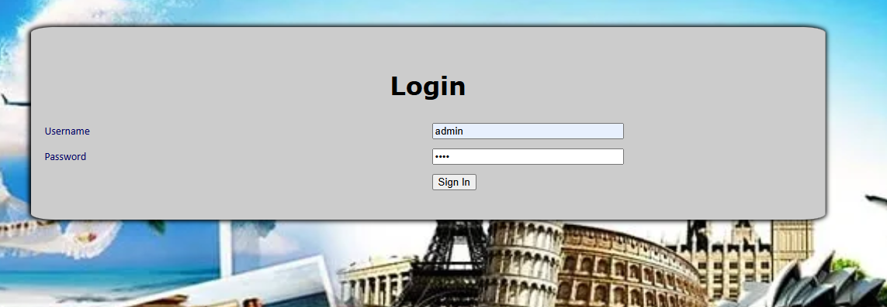
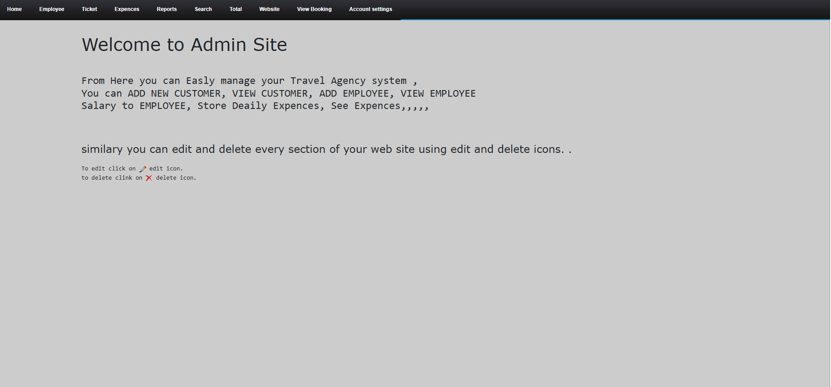
5.1.1 Output Testing

Slide 48
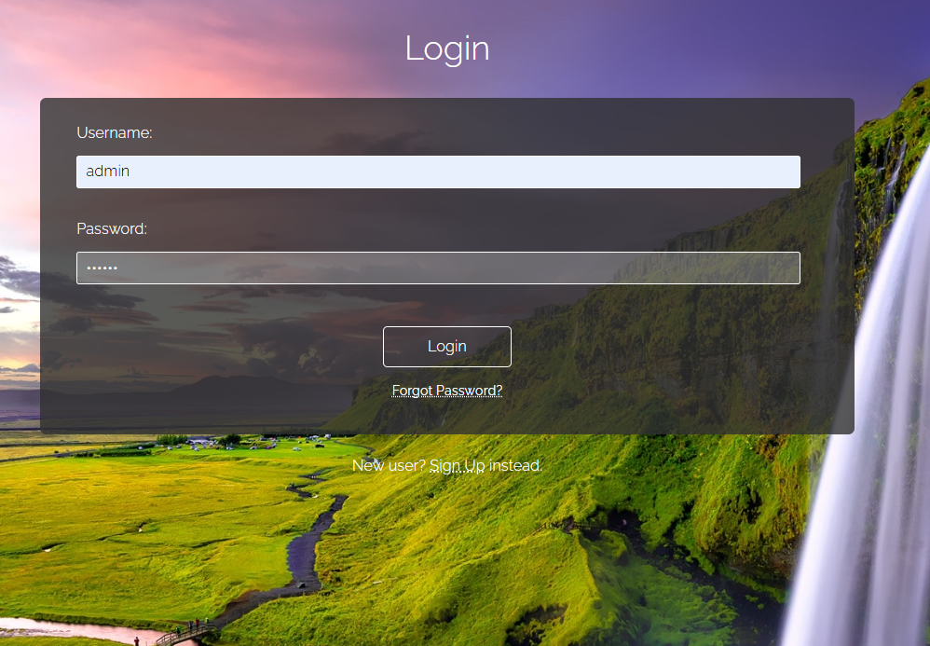
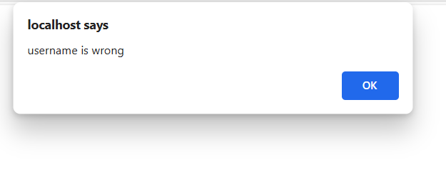
Wrong Id and Password :- Not able to Admin Login

Slide 49
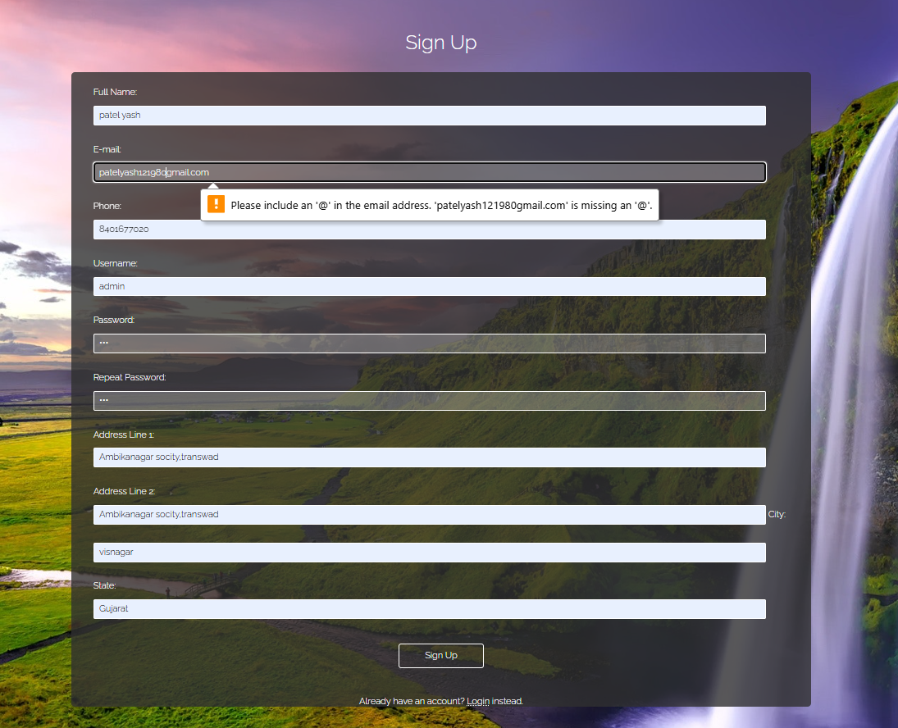
Enter email Without @ it is not allowd

Slide 50
CONCLUSION AND FUTURE ENHANCEMENT
*
<Group No.- Project Title>

Slide 51
6.1 Conclusion
The project successfully integrates tourism services with package booking and management, offering a one-stop solution for tourists and administrators.
Automating the booking, payment, and record management process saves considerable time and effort for users.
Proper authentication and data encryption mechanisms ensure the privacy and security of user data.
The built-in package management system enables administrators to create, update, and manage tour packages easily, without needing external tools.
Tourists can explore destinations, book packages, and track their travel history efficiently, while administrators can maintain structured records of customers, bookings, and payments.

Slide 52
6.2 Future Enhancements
To enhance the Travel and Tourism Management System and provide a richer travel experience, several key improvements are planned. Future updates will include AI-driven travel recommendations to deliver personalized trip suggestions based on user preferences and real-time booking/travel status tracking for better transparency.
Push notifications will be implemented to alert users about special offers, booking confirmations, itinerary updates, and new travel packages. To make trip planning easier, advanced search filters and voice-based search options will be added for destinations, hotels, and tours.
On the security front, two-factor authentication and enhanced payment gateway integration will ensure safer and more reliable transactions.
These enhancements aim to make the Travel and Tourism Management System more intelligent, secure, and user-friendly, offering a seamless and personalized experience for travelers.

Slide 53
BIBLIOGRAPHY & REFERENCES
*
<Group No.- Project Title>

Slide 54
7.1 Books References
Holloway, J. C., & Humphreys, C. The Business of Tourism, Sage Publications, 2019.
Goeldner, C. R., & Ritchie, J. R. B. Tourism: Principles, Practices, Philosophies. Wiley, 2012.
Russell, J. T. & Charles, R. Tourism and Hospitality Management, Oxford University Press, 2017.
Meloni, Julie C. PHP, MySQL, JavaScript & HTML5 All-in-One For Dummies, Wiley, 2018.
Welling, L., & Thomson, L. PHP and MySQL Web Development, Addison-Wesley, 2016.

Slide 55
7.2 Web References
MySQL Official Documentation – https://dev.mysql.com/doc/
W3Schools PHP Tutorial – https://www.w3schools.com/php/
TutorialsPoint PHP Programming – https://www.tutorialspoint.com/php/
GeeksforGeeks PHP Development – https://www.geeksforgeeks.org/php/
MDN Web Docs (HTML, CSS, JavaScript Reference) – https://developer.mozilla.org/
PHP Official Documentation – https://www.php.net/docs.php
UNWTO (World Tourism Organization) – https://www.unwto.org/

